Slide 1
API project
Mahmoud Tarek EL-Alfy

Slide 2
Agenda
What is the API?
What is the JSON?
What is POSTMAN?
Why we choose POSTMAN?
BUILD JSON SERVER
POSTMAN UI

Slide 3
Agenda
POST REQUEST
GET REQUEST ​
PUT REQUEST
DELETE REQUEST
POSTMAN COLLECTION
POSTMAN SNEPPETS (TC)

Slide 4
Agenda
ENVIRONMENT
MOCK API
AUTHORIZATION
RUN E2E
RUN E2E NEWMAN
RUN E2E JENKINS

Slide 5

What is the API?
Application Programming Interface, which is a software intermediary that allows two applications to talk to each other
API defines how the two communicate with each other using requests and responses.
Their API documentation contains information on how developers are to structure those requests and responses.

Slide 6
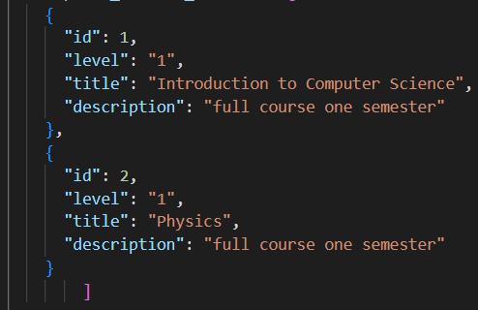
What is the JSON?
JSON stands for JavaScript Object Notation
JSON is a lightweight format for storing and transporting data
JSON is often used when data is sent from a server to a web page
JSON is "self-describing" and easy to understand
We use Visual Studio Code to create JSON file with a special format

Slide 7

What is POSTMAN?
Postman is an API platform for building and using APIs
Postman is an API(application programming interface) development tool which helps to build, test and modify APIs

Slide 8
Why we choose POSTMAN?
Postman is a great tool when trying to dissect RESTful APIs made by others or test ones you have made yourself. It offers a sleek user interface with which to make HTML requests, without the hassle of writing a bunch of code just to test an API's functionality.

Slide 9


BUILD JSON SERVER
The JSON server provides us with a great service in creating a full fake API and DATABASE
To build server we need to install
1- JSON server
2- NODEJS
3- create file db.json
4-write this command in CMD

Slide 10
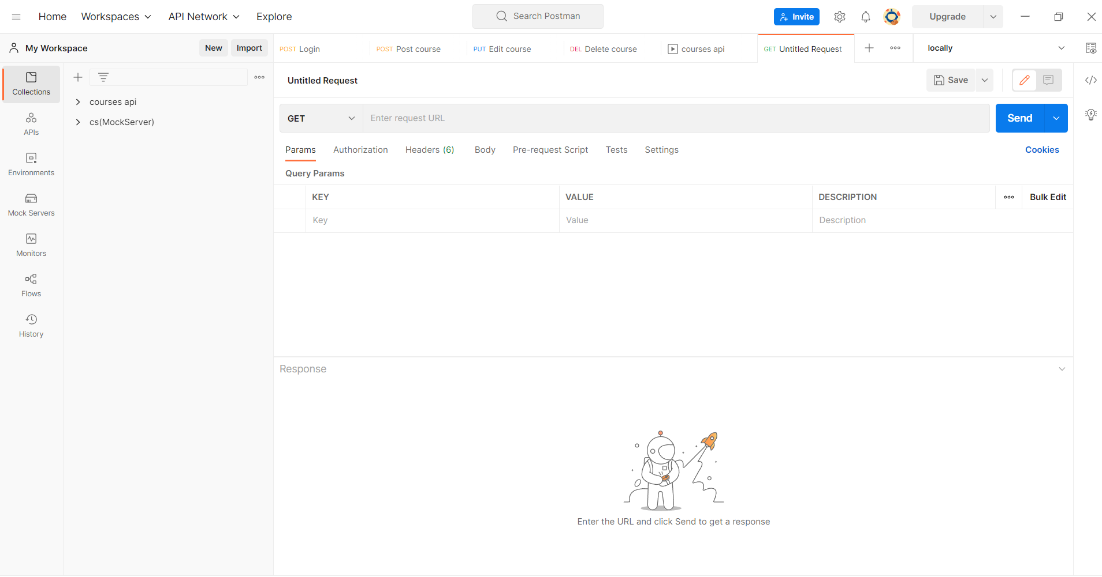
POSTMAN UI

Slide 11
REQUESTs
Post: POST request are used to send data to the API server to create resource using a given URI
Get: GET request is used to retrieve information from the given server using a given URI
Put: PUT request updates an existing resource using a given URI
Delete: DELETE request is used to delete a resource from the server using a given URI

Slide 12
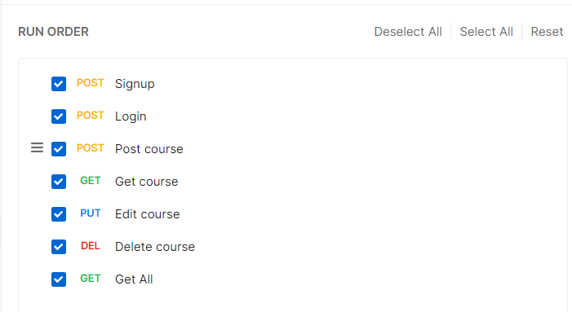
POSTMAN COLLECTION
The Collection Runner allows you to run sets of requests in a specified sequence.

Slide 13
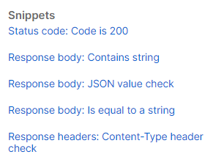

POSTMAN SNEPPETS (TC)
Tests confirm that your API is working as expected, that integrations between services are functioning reliably, and that any changes haven't broken existing functionality. You can write test scripts for your Postman API requests in JavaScript.

Slide 14
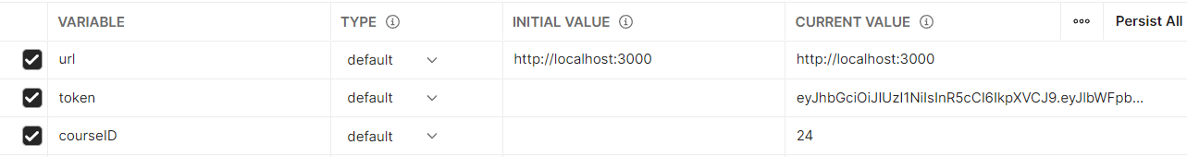

ENVIRONMENT
An environment is a set of variables you can use in your Postman requests

Slide 15
MOCK API
mock server API imitates a real API server by providing realistic mock API responses to requests.
They can be on your local machine or the public Internet.

Slide 16
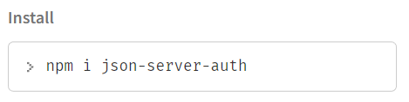
AUTHORIZATION
Authorizing requests include authenticating the identity of the users who sends the request
We should write in URL this number /660/
You can make a lot of AUTHORIZE but we used (Bearer Token)
To install write this in CMD & to run to get the URL to go to POSTMAN

Slide 17


RUN
RUN E2E
RUN E2E NEWMAN
RUN E2E JENKINS
Run with collection in postman
Export Collection and environment from Postman
Run CMD in same folder
Write 2 command line
Download Jenkins.war file
Open CMD and write this command java –jar and drop the file
Open (http://localhost:8080/) after download
Select the configuration
Build then take the report

Slide 18



Thank you
Demo
Mahmoud Tarek EL-Alfy
mahmoud.t.elalfy@gmail.com
https://drive.google.com/drive/folders/1cyVcIUsC_A2ygtxiEKMQddSD_jmKcCkl?usp=sharing

